Slide 1

AIDI 1010- Group 9 Project

Slide 2

Topics
Group Introduction
What we are trying to solve
What we want to implement
What we have done so far
What next
Here we conclude
Questions?

Slide 3
Group Introduction
What we are trying to solve
What we want to implement
What we have done so far
What next
Here we conclude
Questions?

Slide 4

Group 9
Nitin
Sweta
Raj
Shreya
Prarthana

Slide 5
Group Introduction
What we are trying to solve
What we want to implement
What we have done so far
What next
Here we conclude
Questions?

Slide 6
Problem Statement
Blood transfusions in the medical industry have proved to be a manual process. We believe it is more important to intelligently automate the blood transfusion supply chain as all critical conditions can require blood at the earliest.
Blood banks and health agencies can organize blood donations more efficiently if they can predict how many people will donate blood based on previous blood donations in blood camps.
The goal of this group project is to anticipate that the past donor will donate blood in upcoming blood donation camps, and from which location blood collecting organizations can have a successful blood collection drive.
Notes:
Explain scenario before talking about the problem statement

Slide 7
Why this needs to be solved
Most blood donors in this developed world are unpaid volunteers.
It is extremely hard for blood banks, hospitals, or the Government to sustain health care without adequate blood from such donors and blood donor organizations.
Blood collecting agencies can plan and efficiently use resources in organizing blood donation camps if they have estimation of how much blood can be collected.
Notes:
Blood donors play a very crucial role in this endeavor.

Slide 8
Research study
Research Paper 1
Uses SVM, ANN, CART, C5.0, Logistic Regression, Logit (Bagging & Boosting), LDA and Random Forest. They have also tried try 5-fold and 10-fold cross-validation
Research Paper 2
Uses Decision Tree, SVM and Artificial Neural Networks to make predictions about donors
Notes:
Both research papers talk about blood transfusion and find out potential donors. The approach which we are using is the same as the approaches used in both the research paper. In both the research paper it is shown that the SVM has the highest accuracy when compared with the other algorithm.

Slide 9
Group Introduction
What we are trying to solve
What we want to implement
What we have done so far
What next
Here we conclude
Questions?

Slide 10
To achieve the goal:
Implement traditional ML algorithms, tune hyperparameters and try to get maximum accuracy
Implement AutoML – TPOT
Compare results with and without AutoML
Visualize the predictions based on various locations
Notes:
We analyzed person's blood donation history and we want to predict the likelihood that the person will donate blood in the future or not.
We want to create a prototype model which can be used to build a full-fledge application by blood banks or blood collection agencies.
We want to implement various traditional ML algorithms, tune hyperparameters then we want to see what gives us maximum accuracy. After this, we want to implement AutoML –which is the main goal of the project. We chose TPOT. As we all know TPOT is an open source AUTOML package that uses genatic machine learning programming concept to optimize the best ML pipeline.
After performing both these ways, we want to compare the results with and without AutoML.
At last we will visualize predictions based on different locations using PowerBI Dashboard

Slide 11
Group Introduction
What we are trying to solve
What we want to implement
What we have done so far
What next
Here we conclude
Questions?

Slide 12

Code and results
Progress – till midterm
Data Preparation
Taiwan Dataset March 2007Dataset Description
Implemented:
Support Vector Machine
Logistic Regression
Decision Tree

Slide 13
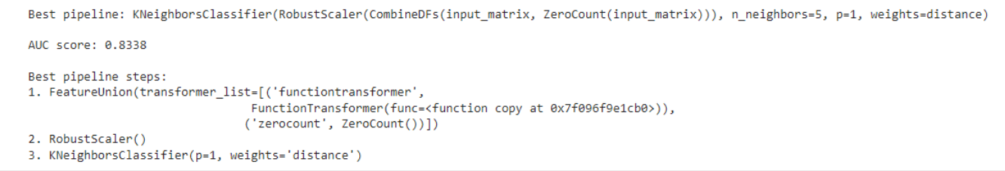
Progress after midterm & Code with TPOT
Data Preparation:
Tried to deal with imbalance in the dataset
Added location data
Implemented TPOT Classifier
Best pipeline extracted by TPOT – Decision Tree Algorithm
Accuracy – 83%

Slide 14
Comparison of with and without AutoML
Without AutoML
The highest achieved accuracy by manually tuning hyperparameters in different models is 77%
Effort to try and different algorithms and tune different hyperparameters
With AutoML
Accuracy achieved is 83%
Effort to implement single classifier is much lesser

Slide 15
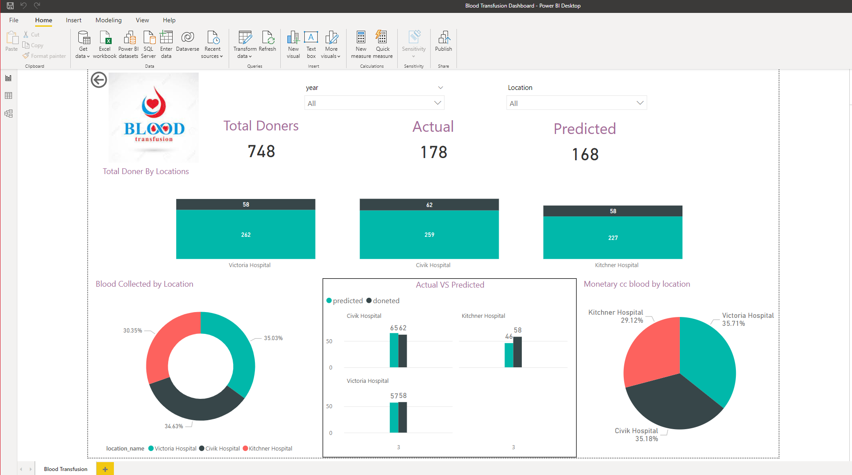
Dashboard

Slide 16
Group Introduction
What we are trying to solve
What we want to implement
What we have done so far
What next
Here we conclude
Questions?

Slide 17
Possible extension of this project
Get actual data from the Government or blood collecting organizations and train model on real data
This process pipeline can be fully automated. This means a working model will keep collecting data after every blood donation drives across all blood donation camps, and use it to improve accuracy of the existing model, and use this improved model for future blood collection drives.

Slide 18
Group Introduction
What we are trying to solve
What we are planning to do
What we have done so far
What next
Here we conclude
Questions?

Slide 19
Conclusion
The demand for blood fluctuates throughout the year. As one example, blood donations slow down during busy holiday seasons. An accurate forecast for the future supply of blood allows for an appropriate action to be taken ahead of time and therefore saving more lives.
In this notebook, we explored automatic model selection using TPOT and AUC score we got was 0.8338. This is better than simply choosing all the time (In the field of machine learning, even small improvements in accuracy can be important, depending on the purpose

Slide 20
References
Ashoori, M., et al. (2017). Exploring Blood Donors’ Status Through Clustering: A Method to Improve the Quality of Services in Blood Transfusion Centers. Journal of Knowledge & Health 11(4): page: 73-82.
Deepti Bahel, Prerana Ghosh, Arundhyoti Sarkar, Matthew A. Lanham. Predicting blood donations using machine learning techniques
Raj A, Gupta A & Selvaraj P. (2018). Predicting Donor’s Likelihood of donating blood given various factors. International Journal of Pure and Applied Mathematics.118
Subramanian Mahadevan. et al (2019) A survey on machine learning algorithms for the blood donation supply chain J. Phys.: Conf. Ser. 1362 012124.

Slide 21
Group Introduction
What we are trying to solve
What we are planning to do
What we have done so far
What next
Here we conclude
Questions?

